Slide 1
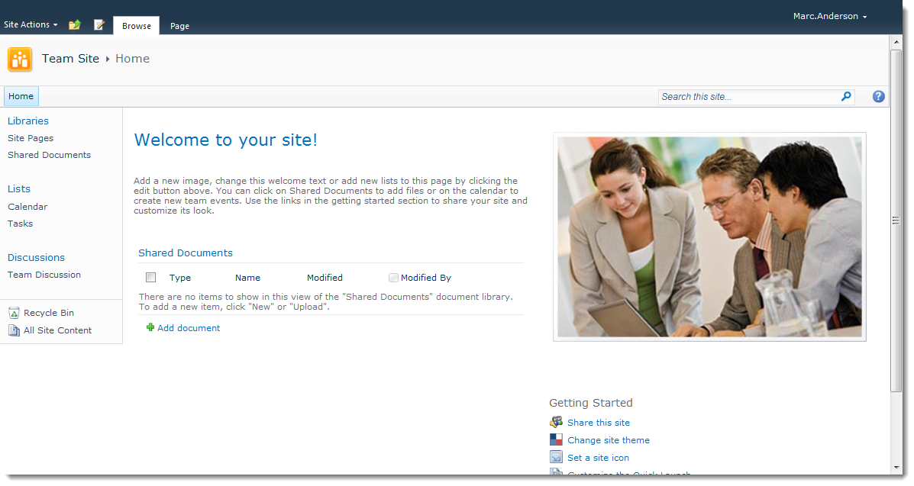
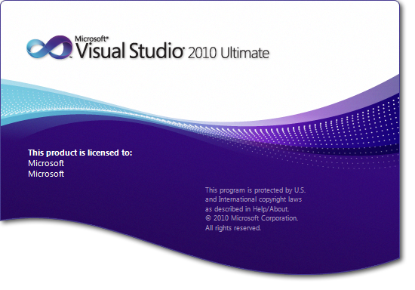
There Are Exactly Two Ways to Develop Solutions in SharePoint…Right?

Slide 2
So You Probably Have to Talk to…
…this guy

Slide 3
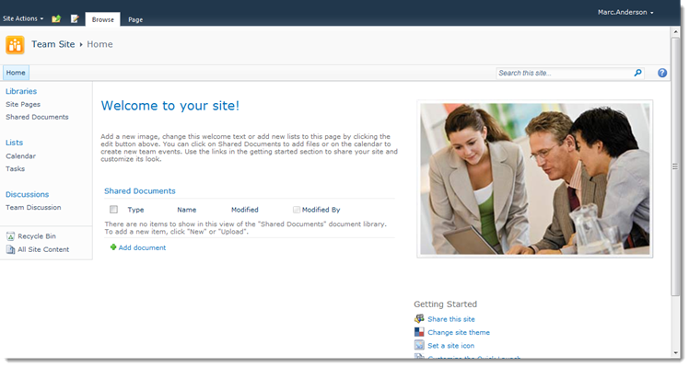
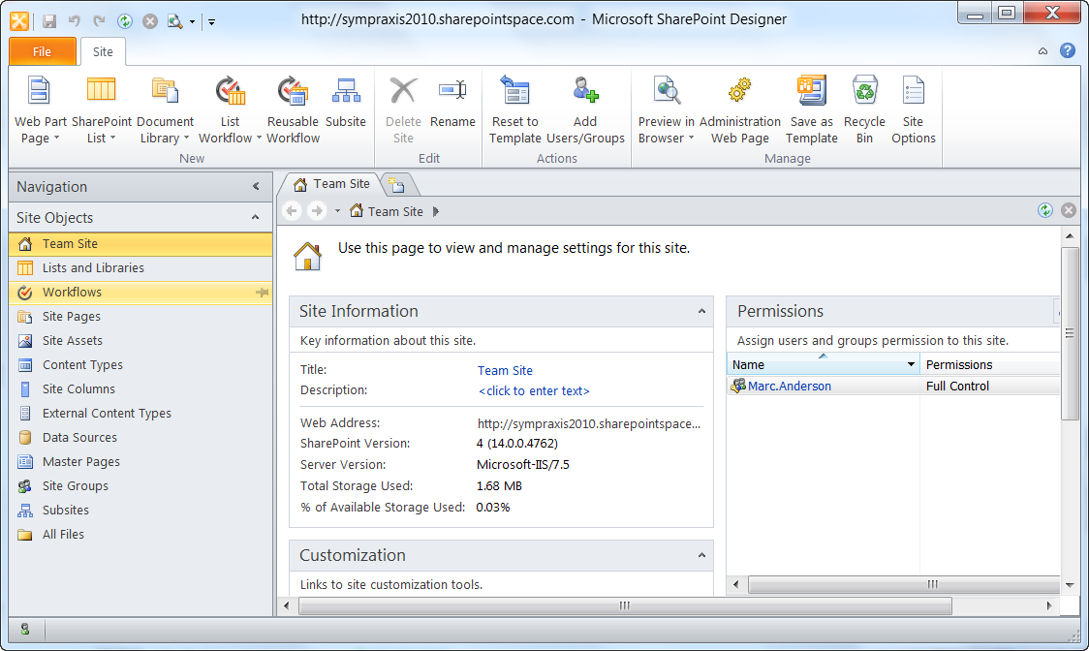
Wrong! There’s a Middle Ground…
…which I call “SharePoint’s Middle Tier”

Slide 4
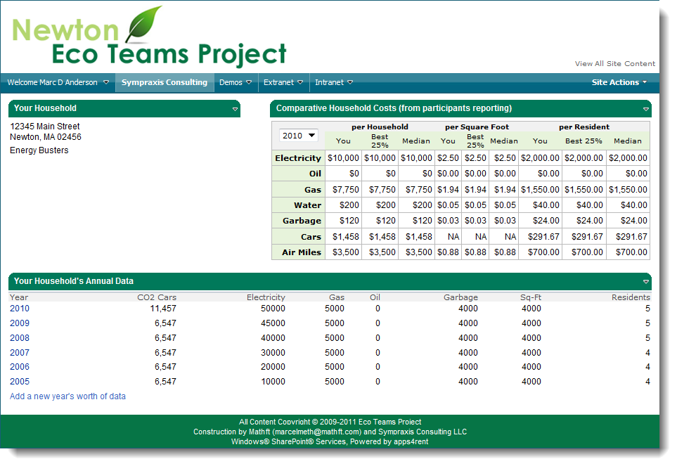
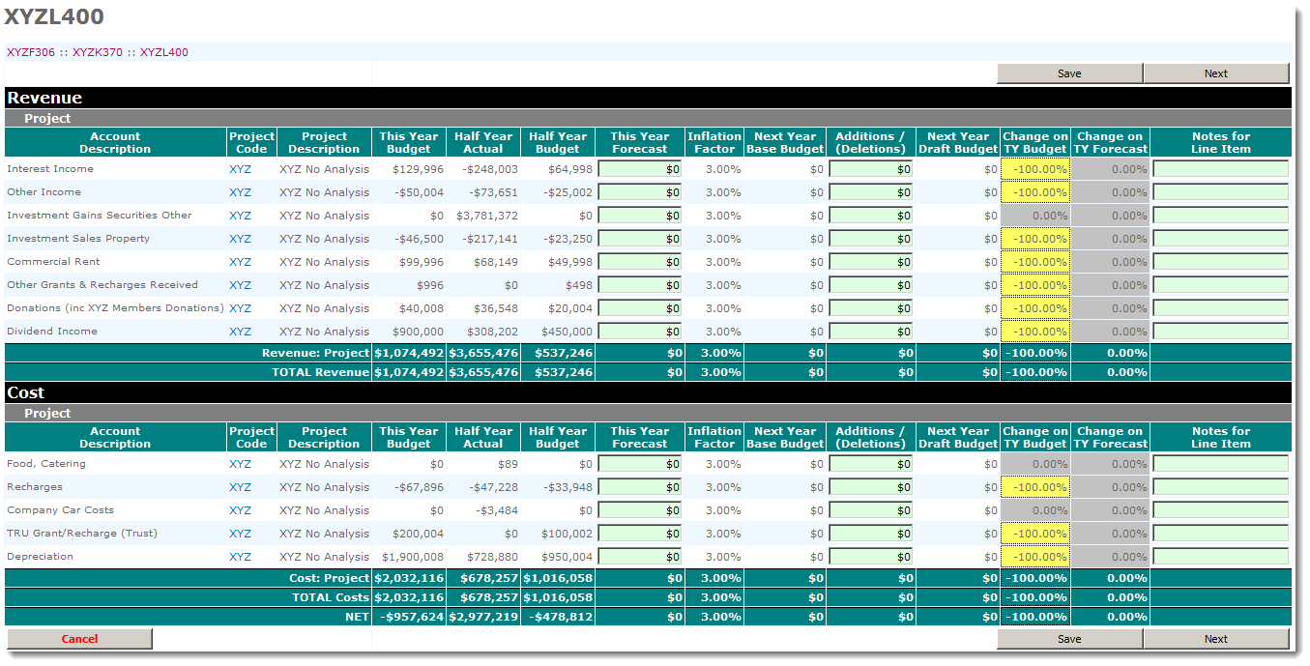
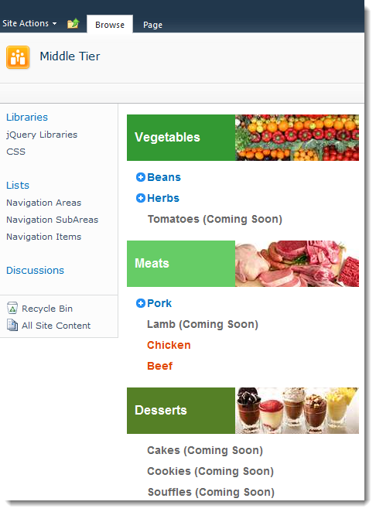
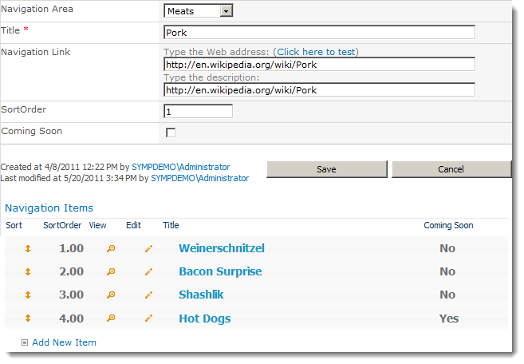
You Can Develop Real Solutions With Just SharePoint Designer
Dashboards
“Spreadsheets”
Real Multipage Applications
Richer Forms
Custom Navigation

Slide 5
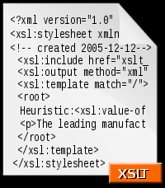
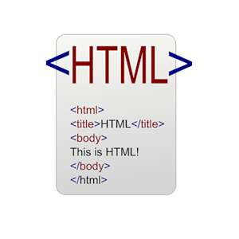
Using Common Web Development Tools…

Slide 6
…and Some Useful SharePoint-Specific Tools

Slide 7
Oh, and These Techniques Work Great in “The Cloud”

Slide 9
Just Kidding

Slide 10
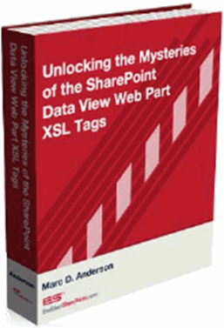
Contact Information
eMail | marc.anderson@sympraxisconsulting.com
Blog | http://sympmarc.com
SPServices | http://spservices.codeplex.com
SPXSLT | http://spxslt.codeplex.com
USPJA Academy | http://uspja.com
eBook | http://endusersharepoint.com
The Middle Tier Manifesto | http://bit.ly/middletier

